Slide 1

Financial and Accounting Analytics of Stock Returns During Market Shock of Early 2022
By: Jacinto Lemarroy

Slide 2
Agenda
1. Intro
2. Risk Exposure
3. Financial Ratios
4. Industry Indicators
5. Regressions
6. Summary and Recommendations

Slide 3

Intro:
Financial analysis of different variables and metrics to analyze stock returns during the Stock Market Shock of Early 2022
Notes:
State the problem, who is the problem relevant to

Slide 4

Risk Exposure
Fama-French Risk Exposures for the list of 3,000 tickers for (i) Market Risk Exposure; (ii) Size Risk Exposure; and (iii) Value/Distress Risk Exposure.
Data
Fama Factors data
WRDS Monthly stock returns
Sample size: 1886
Missing values?
Filled with mean
Mktrf, smb, hml
Loop
Create dataframe for each tic monthly data
Merge datasets
Ran OLS regression for each stock using FF 3-Factor model
Extract output items

Slide 5
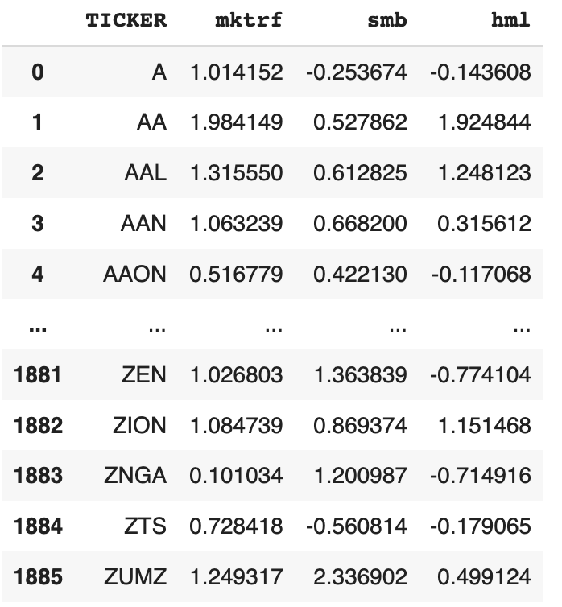
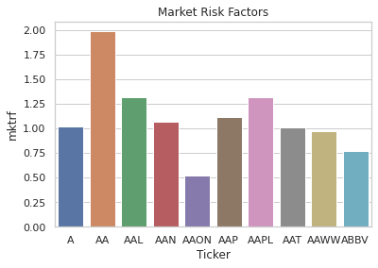
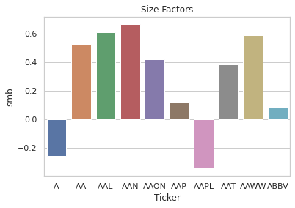
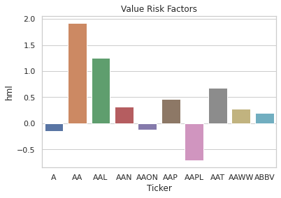
Risk Exposure

Slide 6
Financial Ratios
Using 10 different relevant ratios, including market ratios, to explain a stock’s return in early 2022
Data
Project Tickers data
WRDS financial report data
Sample size: 1886
Missing values?
Filled with mean
Steps
Preprocessing: Examine, rename, NA
Merge datasets
Created ratios for each stock
Checked distribution and outliers of ratios
Winsorized

Slide 7
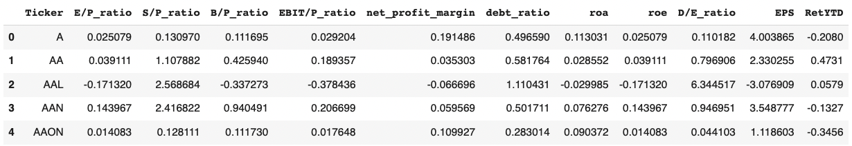
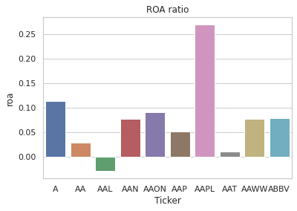
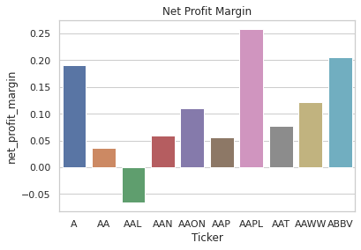
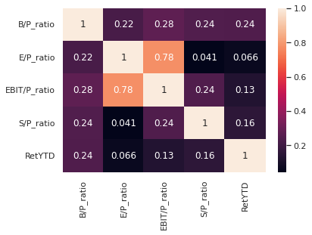
Financial ratios

Slide 8
Industry Indicators
Determining industry indicators for each stock in the list
Data
Project Tickers data
WRDS sector data
Sample size: 1886
Missing values?
0
Steps
Preprocessing: Examine, dropping, NA
Merge datasets
Created industry dummies

Slide 9
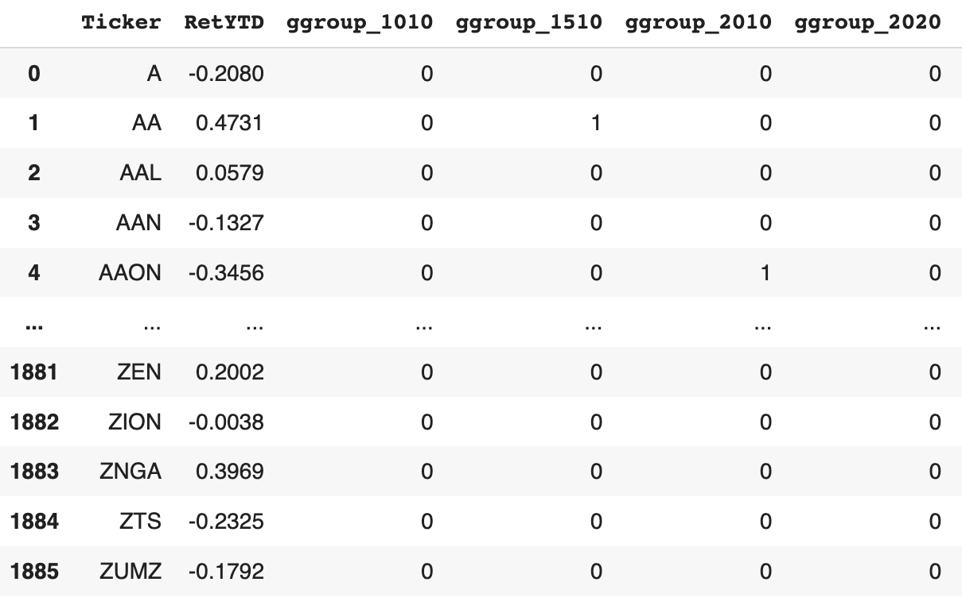
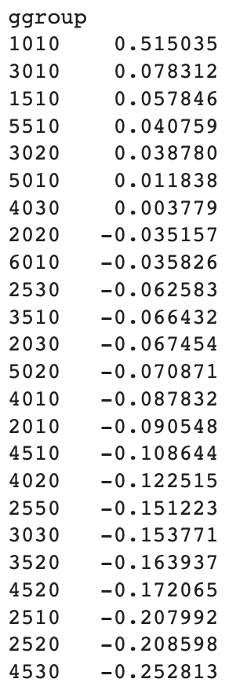
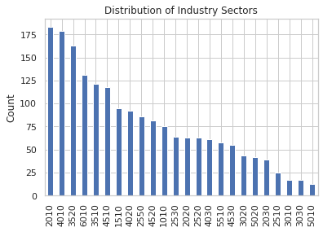
Industry Indicator
Top industries based on count: Capital Goods, Banks, Pharmaceuticals

Slide 10
Regressions
Running OLS explanatory for 4 categories
Risk Regressions:
Ret(i) = a + b1*MktExposure(i) + b2*SizeExposure(i) + b3*ValueExposure(i) + e
Financial Characteristics:
Ret(i) = a + c1*Ratio1(i) + c2*Ratio2(i) + … + c10*Ratio10 (i) + e
Industry Dummies
Ret(i) = a + coefficients*IndustryDummies + e
0
Combined Regressions
Combined the various regressions in previous steps

Slide 11
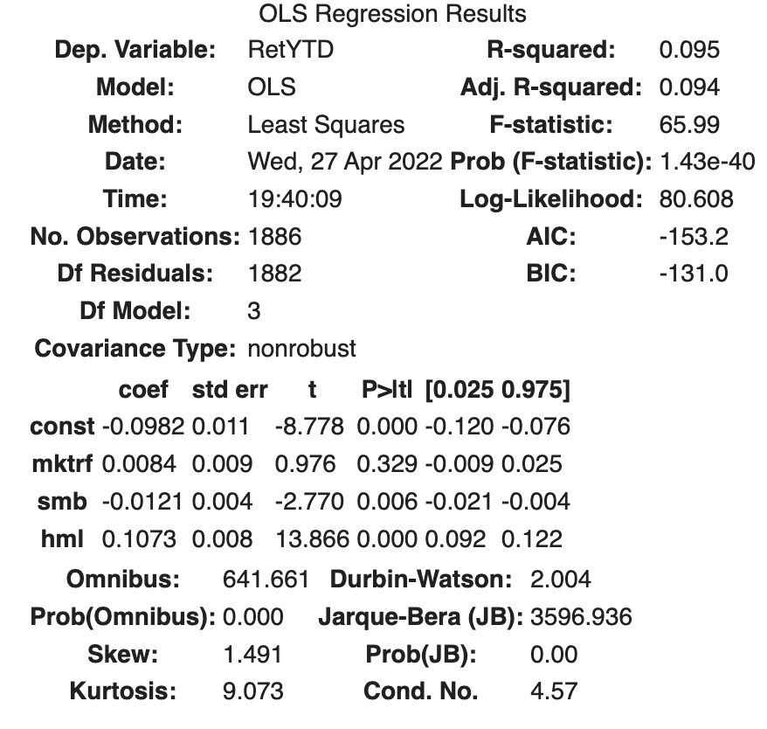
Risk Regression
R-squared and adjusted R-squared
9.5% of the stocks' return explained by market, size and value risk factors
Coefficients
Constant
Alpha
Over the early months of 2022, beyond what happened with the stock market(mktrf), and the other two risk factors, the stock portfolio went down by 9.8% on average
Mktrf
The value of the coefficient tells us that the average value of the stock portfolio is less volatile than the market since it is less than 1
Smb
The sign of the coefficient tells us that the portfolio of stocks looks more like large stocks
Hml
The sign of the coefficient tells us that the portfolio of stocks looks more like value stocks.

Slide 12
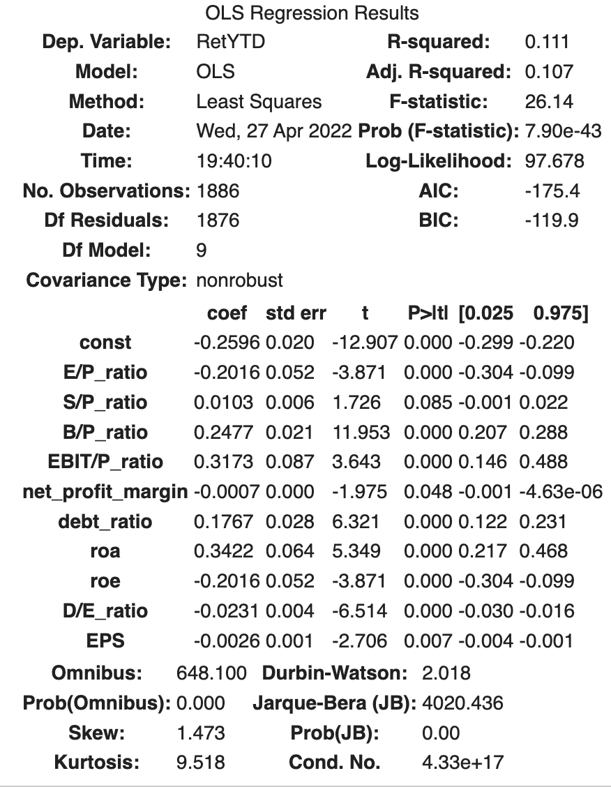
Financial Ratios Regression
R-squared and adjusted R-squared
~ 10% of the variance in the stocks' return is explained by the financial ratios
More explained variance than Fama French variables
Notable Coefficients
ROA (Return on Assets) with highest positive coefficient value at 0.3422. When ROA increases by 1, RetYTD is expected to increase by 0.3422.
EBIT/P_ratio (EBIT to Price ratio)
B/P_ratio (Book to Price ratio)

Slide 13
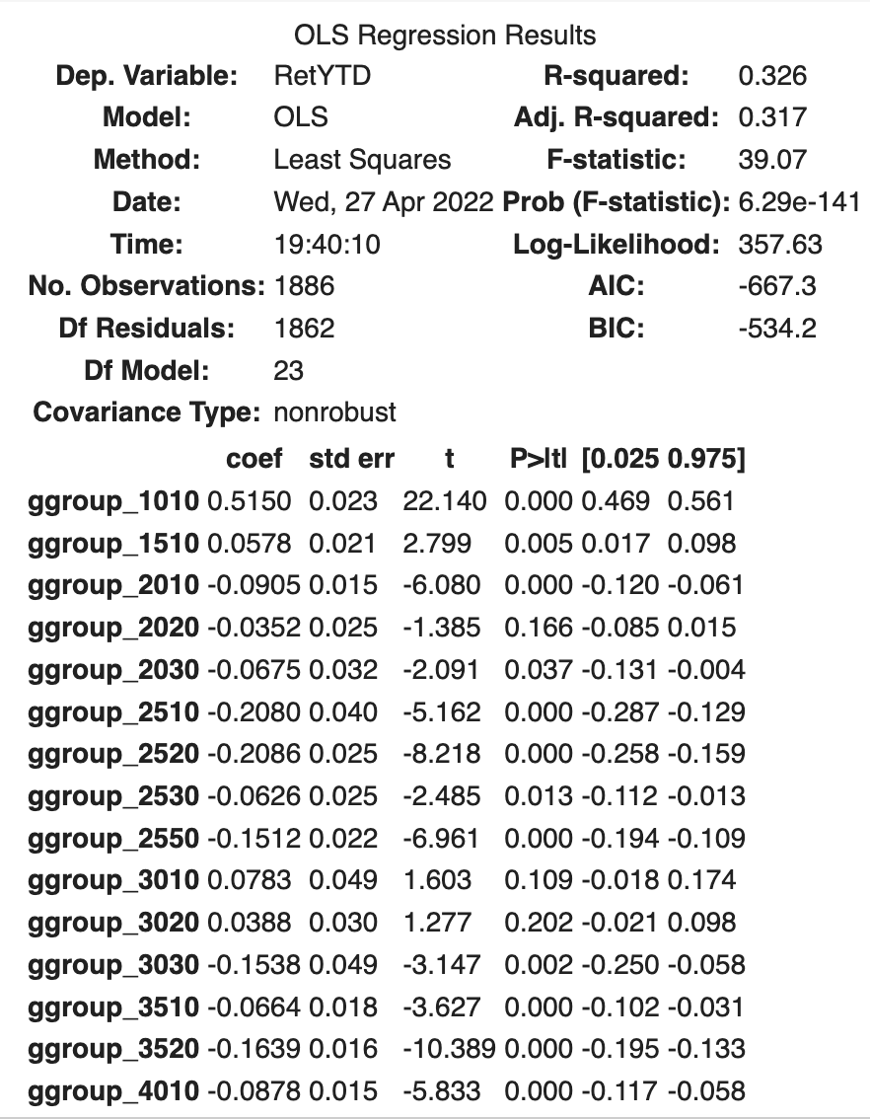
Industry Indicators Regression
R-squared and adjusted R-squared
~ 31% of the explained variance in the stocks' return
Better at explaining the variance in stock returns (Adj R2~31%) compared to the fama french variables and the ratios.
Notable Coefficients
ggroup_1010 (Energy Sector)
ggroup_4530 (Semiconductors & Semiconductor Equipment Sector)
ggroup_2520 (Consumer Durables & Apparel Sector)
ggroup_2510 (Automobiles & Components Sector)

Slide 14
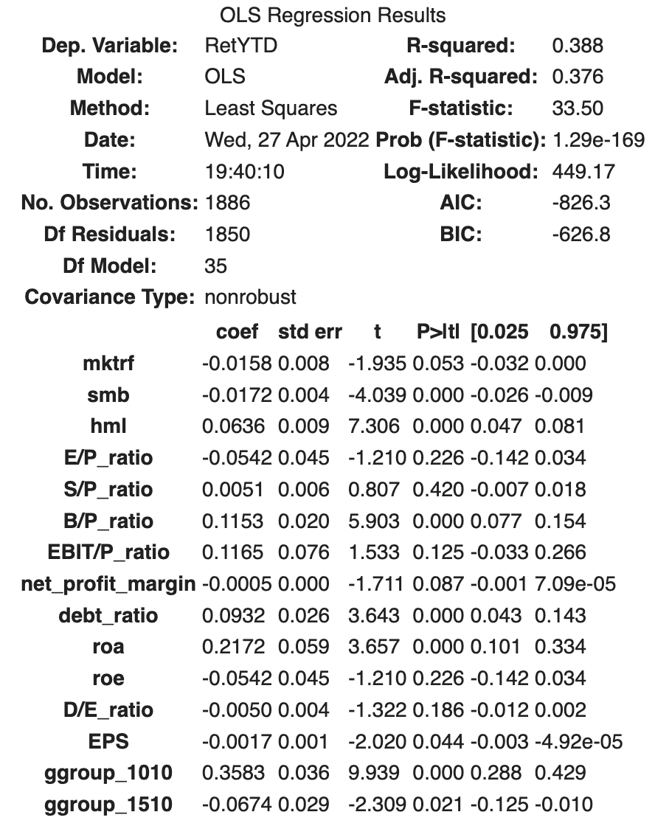
Combined Regression
Around 37% of the variance in the stocks' return is explained by the fama french metrics, financial ratios and industry indicators.
This combined regression performs even better explaining the variance in stock returns (Adj R2~37%) when adding more variables, when compared to the previous three standalone regressions.
When analyzing the other three regressions, we can conclude that industry indicators explained most of the financial returns variance.

Slide 15
Conclusion and Recommendations
Conclusion from Regressions
Invest/Buy Energy Sector ; Avoid Semiconductors Sector and Consumer Durables & Apparel Sector
Recommendations
Diversify your portfolio. The stock market is very volatile and hard to predict, there are too many factors outside of the variables in the regressions that we did not contemplate. Diversifying the portfolio allows you to reduce the portfolio risk so that one asset performance does not affect your entire portfolio
Re-tune your model and add other factors if possible. For ratios, the best performing ones appear to be ROA, EBIT-to-Price ratio and Book-to-Price ratio

Slide 16
Thank You!!

